Slide 1
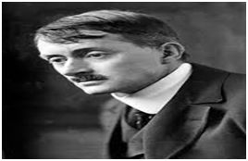
Laugh And Be Merry By John Masefield
britannica.com (google images)
John Masefield (1878-1967) : was an English poet, prose-writer and journalist.
-He could not resist the call of sea.
-He joined Navy but ill health compelled him to quit it.
-After that he led vagrant life shifting from place to place but he continued writing.
-He was a voluminous writer. In all he wrote fifty volumes of verse, twenty novels and eight plays.
-Chiefly he wrote lyrics and narratives dealing with the life on the sea and the life of the poor. He was appointed poet Laureate in 1930
(Poet Laureate: in Britain, a poet given a special position by the king or queen, who is asked to write poems about important public occasions )

Slide 2
Stanza 1
blow in the teeth of a wrong: by opposing injustice
a thread the length of a span: duration of life
the old proud pageant of man: series of impressive events.
Laugh and be merry, remember, better the world with a song,
Better the world with a blow in the teeth of a wrong.
Laugh, for the time is brief, a thread the length of a span.
Laugh and be proud to belong to the old proud pageant of man.

Slide 3
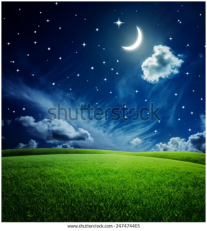
Stanza II
(shutterstock.com (google images)
Laugh and be merry: remember, in olden time.
God made Heaven and Earth for joy He took in a rhyme,
Made them, and filled them full with the strong red wine of
His mirth
The splendid joy of the stars: the joy of the earth.

Slide 4
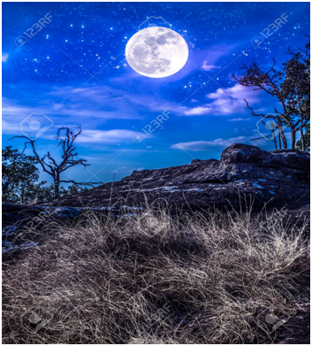
Stanza 3
So we must laugh and drink from the deep blue cup of the sky,
Join the jubilant song of the great stars sweeping by,
Laugh, and battle, and work, and drink of the wine outpoured
In the dear green earth, the sign of the joy of the Lord.
123rf.com (google images)

Slide 5
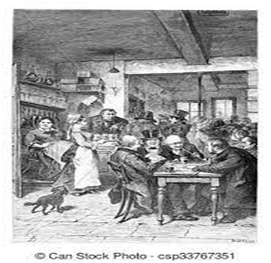
Stanza 4
Laugh and be merry together, like brothers akin,
Guesting awhile in the rooms of a beautiful inn,
Glad till the dancing stops, and the lilt of the music ends.
Laugh till the game is played; and be you merry, my friends.

